Slide 1

Automatic Speech Recognition (ASR)
ASR Team, MLLIP
October 11, 2024

Slide 2
Timeline
April, 2024
Data Pre-processing
- Verbalization
- Spell Checking
- Tokenization
July, 2024
DNN-HMM: Time Delay Neural Network – Hidden Markov Model (TDNN-HMM)
March, 2024
Dataset Creation
- Text Transcription Preparation
- Speech Recording
June, 2024
Baseline: Gaussian Mixture Model – Hidden Markov Model (GMM-HMM)
December, 2024
End-to-End DNN: Joint CTC-Attention and RNN Language Model

Slide 3
What is Automatic Speech Recognition?
ASR, often known as voice recognition, is a technique that transcribes spoken words into written text.
The main objective of speech recognition systems is to transcribe spoken words with high accuracy and efficiency into a format suitable for processing, storage, or diverse applications.
This technology leverages complex algorithms, machine learning and deep learning techniques to interpret and understand human speech patterns.

Slide 4





Applied Areas
Transcription
Services
Customer
Services
Accessibility
Features
Virtual
Assistant
Smart
Homes
Notes:
Transcription Services: ASR systems are employed for converting spoken language into written text, facilitating tasks like transcription of meetings, interviews, or dictation.
Virtual Assistants: Virtual assistants like Siri, Google Assistant, and Alexa use speech recognition to understand and respond to user commands and queries.
Customer Service: Speech recognition uses in automated voice systems in call centers to understand and respond to customer inquiries.
Smart Homes: speech recognition utilize in voice-activated devices in smart homes for tasks such as controlling lights, and other connected devices.
Accessibility Features: For individuals with disabilities, ASR enhances accessibility by allowing them to control devices or communicate using their voice.

Slide 5





Process of ASR
Speech
Feature
Extraction
Acoustic
Model
မြန်မာ စာ ဖွံ့ဖြိုး တိုးတက် ရေး စီမံကိန်း မှ ကြိုဆို ပါ တယ်
Language
Model
Decoding
Notes:
Speech: The acoustic signal input for a speech recognition system is the uttered work in analogue waveform. This signal is recorded by a microphone or telephone and subsequently transformed into a digital format.
Feature Extraction: Pitch, intensity, and other pertinent features are extracted by the system from these digital signals. These features are used to represent unique aspects of spoken language.
Acoustic Model: An acoustic model serves as a statistical framework designed to identify the acoustic characteristics of speech. Machine learning and deep learning techniques, such as Hidden Markov Models (HMMs) or Deep Neural Networks (DNNs), are often used to create these models.
Language Model: In addition to acoustic models, language models are used to understand the context and structure of speech. Language models make it better at understanding words in the right linguistic context. In traditional ASR, lexicon of text transcription is needed but there is no need especially in end-to-end ASR.
Decoding: The system uses the acoustic and language models to decode the input signal and generate a sequence of words or phrases that best represent the transcription of the spoken language.

Slide 6
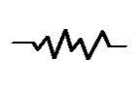
Architecture of ASR
Training Phase
Input Speech
Testing Phase
Speech Dataset
Feature Extraction
Feature Extraction
Acoustic Model
Text Corpus
Language Model
Decoding Engine
Recognized Text
Pronunciation Lexicon

Slide 7
Towards End-to-End RNN Speech Recognition
Architectures
GMM-HMM: 30 years of feature engineering
DNN-GMM-HMM: Trained features
DNN-HMM: TDNN, LSTM, RNN
DNN for language modeling (RNN)
End-to-End DNN

Slide 8
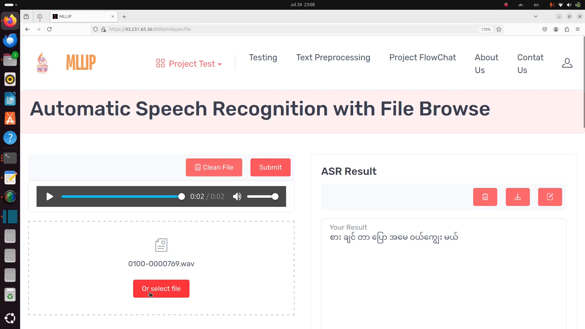

Slide 9
Challenges of Myanmar Language in ASR System
Complex Script & Tokenization
Tone and Phoneme Variability
Language Model Challenges
Syllabic Script
Segmentation
Tokenization Strategies
Tonal Language
Phoneme Ambiguity
Word Order
Homophones
Limited Resources
Dialectal Variations
Cultural & Contextual Understanding
Dataset Shortage
Pretrained Models
Regional Accents
Speaking Styles
Context-Sensitive Meaning
Notes:
1. Complex Script and Tokenization
Syllabic Script: Myanmar uses syllable-based writing, making tokenization harder than in languages with clearer word boundaries.
Segmentation: The lack of spaces between words in written Burmese complicates text segmentation.
Tokenization Strategies: Syllable-based tokenization generally performs best but still poses challenges compared to character, subword, or word-based methods.
2. Tone and Phoneme Variability
Tonal Language: Myanmar has three tones (high, low, creaky), which ASR systems must distinguish between.
Phoneme Ambiguity: Some phonemes are difficult to differentiate, causing frequent misrecognition.
3. Language Model Challenges
Word Order: Myanmar’s subject-object-verb structure differs from many languages, complicating language modeling.
Homophones: Words that sound alike but have different meanings increase the difficulty for ASR systems.
4. Limited Resources
Dataset Shortage: Few large-scale, high-quality Myanmar speech datasets are available for ASR training.
Pretrained Models: Fewer pretrained models exist for Myanmar, requiring ASR models to be built from scratch.
5. Dialectal Variations
Regional Accents: Different accents across regions in Myanmar make generalization difficult for ASR systems.
Speaking Styles: Formal and informal speech variations require diverse training data.
6. Cultural and Contextual Understanding
Context-Sensitive Meaning: Words in Myanmar can change meaning based on context, making them difficult for ASR systems to interpret accurately.

Slide 10
Myanmar Language and Literature Improvement Project (MLLIP)
Address:
MLLIP, Office-13, Ministry of Education, Naypyitaw, The Republic of the Union of Myanmar.
- FUTURE IS NOW -

